Slide 1
VHDL Sound Generator

Slide 2
First Cut
Single Tone
Ex:
16-bit counter
Clocked at 50 MHz
MSB = 50,000,000 / 2^16 = 762.93 Hz
Symmetric waveform since there’s a full count
Code: Counter16Bit.vhd

Slide 3
First Cut (cont’d)
16-bit
Up
Counter
MSB
Sound Out
to Buzzer
CLK50
50 MHz
Clock
Notes:
1

Slide 4
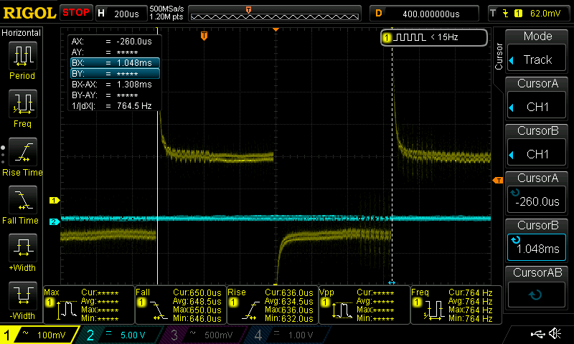
First Cut (cont’d)

Slide 5
First Cut (cont’d)
Expected 763 Hz
Measured 764 Hz (with cursors)
A lot of over/undershoot @ buzzer pin
Limitations
No mute control
Fixed Frequency
Square Wave sounds really annoying

Slide 6
First Cut (cont’d)
In pin list at top of Microprocessor entity
BUZZER : out std_logic;
Assign BUZZER to Pin 85 in the Pin Planner
In the architecture of Microprocessor
buzzCounter: entity work.Counter16Bit
port map(
clock => clk,
Q => BUZZER
);

Slide 7
First Cut (cont’d)
Create Counter16.vhd file and include in project
entity Counter16Bit is
port(
clock: in std_logic; – 50 MHz clock
Q: out std_logic – Most Signif Bit of counter
);
end Counter16Bit;
architecture behv of Counter16Bit is
signal Pre_Q: std_logic_vector(15 downto 0);
begin
process(clock, Pre_Q)
begin
if rising_edge(clock) then
Pre_Q <= Pre_Q + 1;
end if;
end process;
Q <= Pre_Q(15); – MSB of counter goes out
end behv;

Slide 8
First Cut (cont’d)
Add mute control
Use extra bit in the 8 bit register that controls the LEDs
Use D4 bit of register (D0-D3 are LEDs)
Register bit is low at power up
Mute sound when low
Turn on sound with POKE 65492,16 (6502/6809) or OUT 132,16 (Z80)

Slide 9
First Cut (cont’d)
Add signal signal buzz : std_logic;
Change entity callout in Microprocessor buzzCounter: entity work.Counter16Bit port map( clock => clk, Q => buzz – Changed to signal ); Add control BUZZER <= buzz and latchedBits(4);

Slide 10
First Cut
Result
Single tone
Mutable
Accurate (got the frequency expected)
Good Start!

Slide 11
Second Cut
Improvements
Add 2 extra counter bits (18-bit counter)
Route out three counter bits (Q17 downto Q15)
Add counter taps
Select tap with remaining control register bits (D5-D7)
This will give us 3 tones
Select Q15, Q14, Q13
Expect frequencies of 248, 496, and 792

Slide 12
Second Cut
POKE 65492,48 (16 to turn on, 32 for tone)
POKE 65492,80 (16 to turn on, 64 for tone)
POKE 65492,144 (16 to turn on, 128 for tone)
POKE 65492,0 (to turn off)

Slide 13
Second Cut w/ Taps (cont’d)
CPU
N bits
Control
Register
AND-OR
Gates
8
8
MSB
Sound Out
to Buzzer
18-bit
Up
Counter
8
CLK50
50 MHz
Clock
Notes:
<number>

Slide 14
Second Cut
In Microprocessor entity
buzzCounter: entity work.Counter16Bit
port map(
clock => clk,
selectTap => latchedBits(7 downto 5),
Q => buzz
);

Slide 15
Second Cut
In Counter18Bit entity
entity Counter18Bit is
port(
clock: in std_logic; -- 50 MHz clock
selectTap: in std_logic_vector(2 downto 0);
Q: out std_logic -- Most Signif Bit of counter
);
end Counter18Bit;
-- concurrent assignment statement
Q <= ((Pre_Q(15) and selectTap(2)) or (Pre_Q(16) and selectTap(1)) or (Pre_Q(17) and selectTap(0)));

Slide 16
Second Cut (Cont’d)
Limitations
Binary counter every bit is ½ or 2x the previous bit
This is one octave
Steps very small at low frequencies
Steps very big at higher frequencies

Slide 17
Third Cut
Square Wave output
Fixed frequency
Middle C is 261.6265 Hz
50,000,000 clks/sec / 261.6265 Hz = 191,112.13 clocks
Next bit up - 2^18 = 262,144
Use an 18-bit counter
Starting count = 262,144 – 191,112 = 72032
0x11578 = 1 0001 0101 0111 1000
Count up to Terminal Count and then reload
Use Most Significant Counter bit as sound out

Slide 18
Third Cut (cont’d)
LOAD
18-bit
Up
Counter
Compar-
ator
All 1’s
TC
Starting Count
1xx..xx
18
MSB
Sound Out
to Buzzer
CLK50
50 MHz
Clock
Notes:
<number>

Slide 19
Second Cut (Cont’d)
Using Most Significant Bit as output is asymmetric
MSB symmetry is (131072-74032)/262,144 = 22% low/78% high
Desirable is 50%/50% symmetry
Get symmetry by putting a Toggle Flip Flop on the Terminal Count
Requires a bit for FF, but one less counter bit

Slide 20
Sending Output to I/O Pin
Using a LSB of the VGA output for testing
These FPGA retrocomputers use 2:2:2 (R:G:B) outputs to resistor networks
Lowest bit shouldn’t be “missed” in this application

Slide 21
Third Cut
Use same long counter chain
Don’t do a pre-load (do full range count)
Use mux to select counter output bits
Control select mux with register from CPU
Only allows 2X frequencies
50,000,000 MHz / 262,144 = 190.7 Hz
2x = 381.4 Hz, 4X = 762.9 Hz, 8X = 1,525.h Hz

Slide 22
Third Cut (cont’d)
Sounds on keyboards
190.7 Hz = ~ G3
381.4 Hz = ~ G4 (above middle C)
762.9 Hz = ~ G5 (next up)
1,525.h Hz = ~ G6 (next up)

Slide 23
Third Cut (cont’d)
CPU
Data
Latch
18-bit
Counter
4:1
Mux
Toggle
F-F
Buzzer
8
8
4
50 MHz
Clock

Slide 24
Fourth Cut
Use counter
Load counter with starting value
Count from the value to terminal count
Toggle the output every time terminal count is reached

Slide 25
Fourth Cut (cont’d)
Loadable counter entity
entity counterLoadable is
port(
clock: in std_logic;
clear: in std_logic;
loadVal: in std_logic_vector(7 downto 0);
soundOut: out std_logic;
Q: out std_logic_vector(18 downto 0)
);
end counterLoadable;

Slide 26
Fourth Cut
Use DDS to generate precise frequencies
50,000,000 Hz clock is 20 nS accuracy
12 notes per octave on a piano
Every octave doubles the frequency

Slide 27
Fourth Cut (cont’d)

Slide 28
Improving “Fidelity”
Square waves are very harsh
Rising/falling edges have a lot of harmonics
Need to soften the edges or make the steps smaller
Smaller steps with the buzzer reduce the volume

Slide 29
Smoothing the edges
No real options on the card for smoothing the sharp edges
Reduce drive current from 8 mA?
Buzzer has 100 ohm series resistor
Buzzer impedance is TBD

Slide 30
Characterizing the Buzzer
Buzzers are very small tweeters
OK at high frequencies but still low volume
Very poor at low frequencies
Volume vs frequency curve

Slide 31
External Solutions?
I/O connector limitation
All 26-pins are either VGA digital, PS/2 or Power/Ground connections
Overcoming limitations
Could steal lower video bits
Sound with slightly disturb video
Green has 6 bits
Steal least significant bit from Red, Green and Blue
Won’t affect video noticeably in the 2:2:2 Retro-computer case

Slide 32
3-bit D/A
Digitize sine wave
Counter start/stop count

